Slide 1

Deep Convolution Neural Network for Big Data Medical Image Classification
By
N. SRINATH REDDY (21091F0050)
Under the esteemed guidance of
Mrs. B. Swetha _{M.Tech,(Ph.D.)}
Assistant Professor
DEPARTMENT OF MASTER OF COMPUTER APPLICATONS
RAJEEV GANDHI MEMORIAL COLLEGE OF ENGINEERING & TECHNOLOGY
(AUTONOMOUS)
NANDYAL-518501, (Estd-1995)

Slide 2
CONTENTS
Abstract
Introduction
Implementation
Implementation setup
Testing
Test Case Reports
Future Enhancement
Conclusion
Appendix- SnapShots

Slide 3
ABSTRACT
Deep learning is one of the most unexpected machine learning techniques which is being used in many applications like image classiﬁcation, image analysis, clinical archives and object recognition.
With an extensive utilization on of digital images as information in the hospitals, the archives of medical images are growing exponentially. Digital images play a vigorous role in predicting the patient disease intensity and there are vast applications of medical images in diagnosis and investigation.
A pre-trained deep convolution neural network (GoogleNet) is used that which can classifies the various medical images for various body organs. This method of image classiﬁcation is beneﬁcial to predict the appropriate class or category of unknown images. The results of the experiment exhibit that our method is best suited to classify various medical images.

Slide 4
INTODUCTION
Image classification is the primary domain, in which deep neural networks play the most important role of medical image analysis.
The image classification accepts the given input images and produces output classification for identifying whether the disease is present or not. In our model we mainly classify the different types of organs and predict the accuracy.
One of the most imperative problems faced in the domain area of image recognition is the classification of medical images. The major intention of medical image classification is to classify medical images into several elements to assist medical practitioners or physicists in diagnosing disease.

Slide 5
Hence, medical image classification is split into two steps. The first and foremost step of medical image classification is to extract the essential features from the acquired input image.
The second step in medical image classification is utilizing the features to construct models that classify the image data set. In the recent past, medical practitioners customarily utilized their specialized experience to extract features so that classification of medical images could be performed into several classes. However, this manual medical image classification was found to be highly cumbersome and time consuming.

Slide 6
Algorithms:
Convolutional Neural Network(CNN):
It is a type of deep learning algorithm that is particularly well-suited for image recognition and processing tasks.
It is made up of multiple layers, including convolutional layers, pooling layers, and fully connected layers.
The convolutional layers are the key component of a CNN, where filters are applied to the input image to extract features such as edges, textures, and shapes. The output of the convolutional layers is then passed through pooling layers.
Convolutional layers: The convolutional layer is the core building block of a CNN, and it is where the majority of computation occurs. It requires a few components, which are input data, a filter, and a feature map.
Pooling layers: A machine-learning technique widely used that reduces the size of the input and, thus the complexity of deep learning models while preserving important features and relationships in the input data.

Slide 7
GOOGLENET
GoogleNet (or Inception V1) was proposed by research at Google (with the collaboration of various universities) in 2014 in the research paper titled “Going Deeper with Convolutions”.
This architecture was the winner at the ILSVRC 2014 image classification challenge.
It has provided a significant decrease in error rate as compared to previous winners AlexNet (Winner of ILSVRC 2012) and ZF-Net (Winner of ILSVRC 2013) and significantly less error rate than VGG (2014 runner up).
This architecture uses techniques such as 1×1 convolutions in the middle of the architecture and global average pooling.

Slide 8
Features of GoogleNet
The GoogleNet architecture is very different from previous state-of-the-art architectures such as AlexNet and ZF-Net.
It uses many different kinds of methods such as
1×1 convolution
Global average (pooling that enables it to create deeper architecture)

Slide 9
IMPLEMENTATON
TECHNOLOGY:
Python:
Python is an interpreted, object-oriented, high-level programming language with dynamic semantics.
Its high-level built in data structures, combined with dynamic typing and dynamic binding, make it very attractive for Rapid Application Development, as well as for use as a scripting or glue language to connect existing components together.

Slide 10
Python is one of the best languages available and why it’s a great one to start programming with.
Open-source general-purpose language.
Object Oriented, Procedural, Functional
Easy to interface with C/ObjC/Java/Fortran
Easy-is to interface with C++ (via SWIG)
Great interactive environment
Great interactive environment

Slide 11
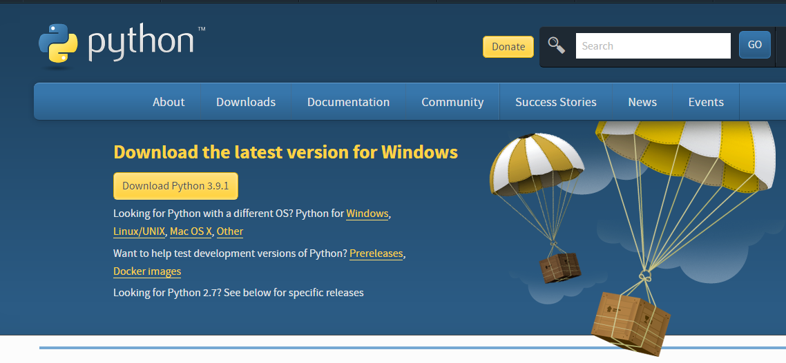
IMPLEMENTATION SETUP
INSTALLING PYTHON:
To download and install Python visit the official website of Python https://www.python.org/downloads/ and choose your version.
Fig2: Python Download Website
Once the download is complete, run the exe for install Python. Now click on Install Now.
You can see Python installing at this point.
When it finishes, you can see a screen that says the Setup was successful. Now click on "Close".

Slide 12
Installing PyCharm:
To download PyCharm visit: website https://www.jetbrains.com/pycharm/download/ and click the "DOWNLOAD" link under the Community Section.
Once the download is complete, run the exe for install PyCharm. The setup wizard should have started. Click “Next”.
On the next screen, Change the installation path if required. Click “Next”.
On the next screen, you can create a desktop shortcut if you want and click on “Next”.
Choose the start menu folder. Keep selected JetBrains and click on “Install”.
Wait for the installation to finish.
Once installation finished, you should receive a message screen that PyCharm is installed. If you want to go ahead and run it, click the “Run PyCharm Community Edition” box first and click “Finish”.
After you click on "Finish," the Following screen will appear.

Slide 13
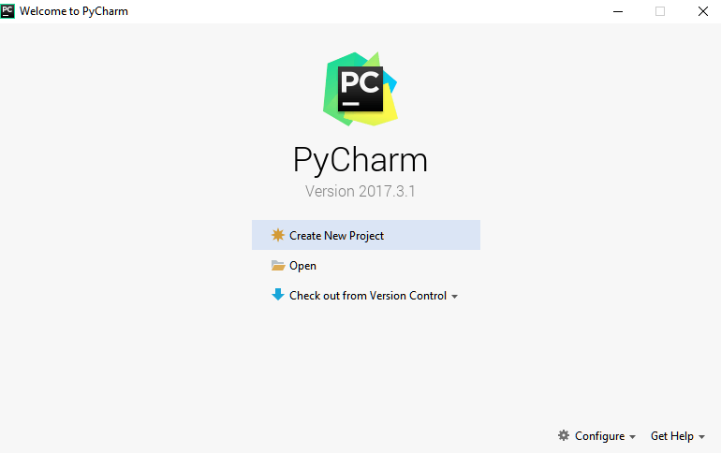
Fig3: Python Software Platform
You need to install some packages to execute your project in a proper way.
Open the command prompt/ anaconda prompt or terminal as administrator.
The prompt will get open, with specified path, type “pip install package name” which you want to install (like NumPy, pandas, sea born, scikit-learn, Matplotlib, Pyplot)

Slide 14
TESTING
The purpose of testing is to discover errors.
Testing is the process of trying to discover every conceivable fault or weakness in a work product.
Software system meets its requirements and user expectations and does not fail in an unacceptable manner.
There are various types of test.
Unit Testing
Integration Testing
Black Box Testing
White Box Testing
Acceptance Testing

Slide 15
Unit Testing:
Unit testing involves the design of test cases that validate that the internal program logic is functioning properly, and that program inputs produce valid outputs.
Unit tests perform basic tests at component level and test a specific business process, application, and/or system configuration.
Integration Testing:
Integration tests are designed to test integrated software components to determine if they actually run as one program.
Integration testing is specifically aimed at exposing the problems that arise from the combination of components.
Black Box Testing:
Black Box Testing is testing the software without any knowledge of the inner workings, structure or language of the module being tested.
Black box tests, as most other kinds of tests, such as specification or requirements document.

Slide 16
White Box Testing:
White Box Testing is a testing in which in which the software tester has knowledge of the inner workings, structure and language of the software, or at least its purpose.
It is used to test areas that cannot be reached from a black box level.
Acceptance Testing:
User Acceptance Testing is a critical phase of any project and requires significant participation by the end user.
It also ensures that the system meets the functional requirements.

Slide 17
FUTURE ENHANCEMENT
In future, we aim to explore large-scale image datasets for medical image classiﬁcation and detection problems.
And we can go for another types of pre-trained algorithms that can perform well and gives high classification. By which, we can classify different types of organs and detect the problems easily

Slide 18
CONCLUSION
For classiﬁcation purpose, deep learning-based framework for medical image classiﬁcation by training the images is proposed.
In this regard, diagnosis is one of the main requirements of the existing era and investigated or examine to speciﬁc diseases.
Hence, we have proposed a novel deep convolution network-based approach that is assist of doctors and physicians in making reasonable decisions.
The results obtained from the proposed method outperformed state-of the-art methods that is reported for the same dataset.

Slide 19
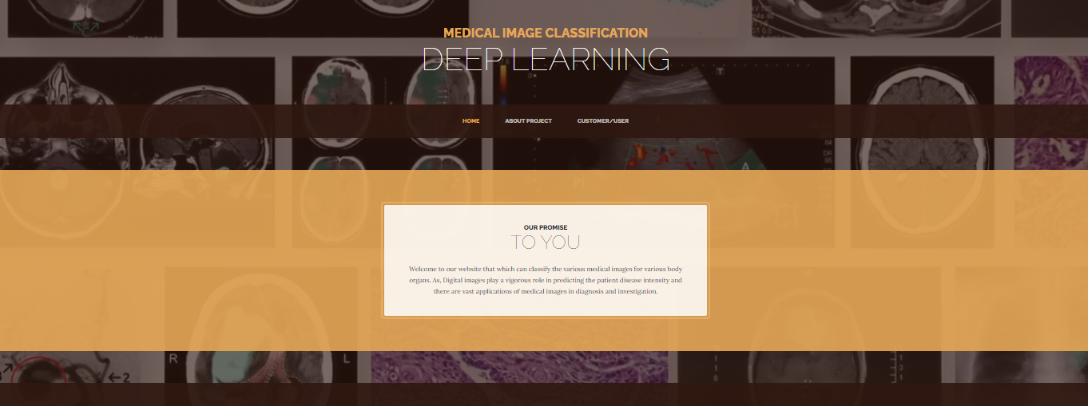
APPENDIX: SNAP SHOTS
Home Page:
Fig1: Home Page

Slide 20
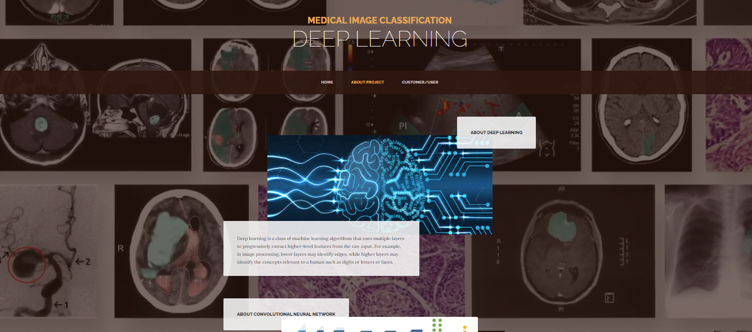
About project:
Fig2: About Project

Slide 21
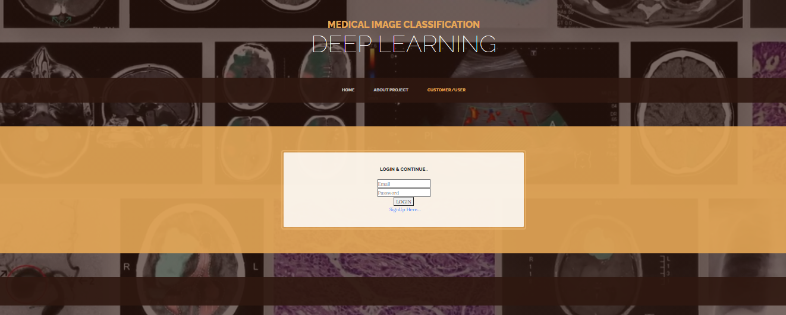
Login Page:
Fig3: Login Page

Slide 22
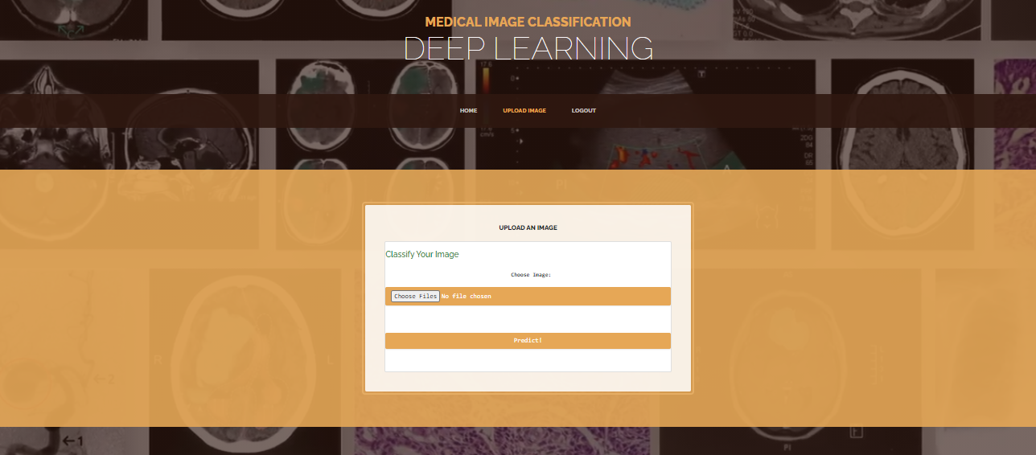
Uploading an Image
Fig4: Uploading an Image

Slide 23
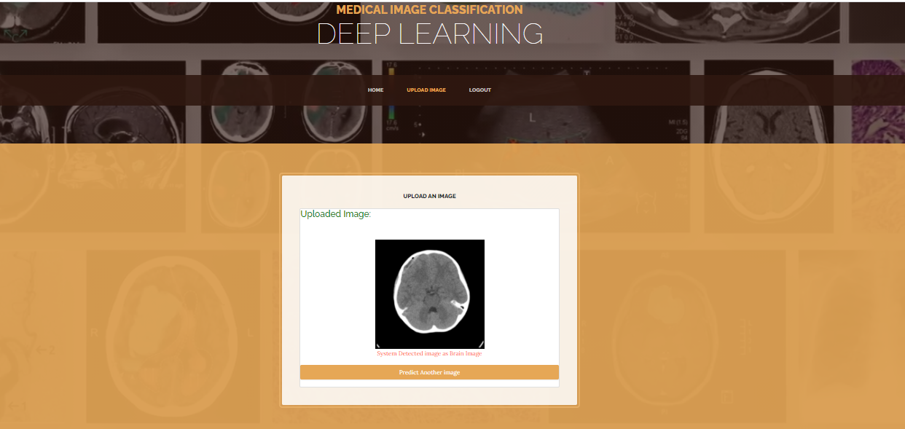
Output image classified as Brain:
Fig5:Output image classified as Brain

Slide 24
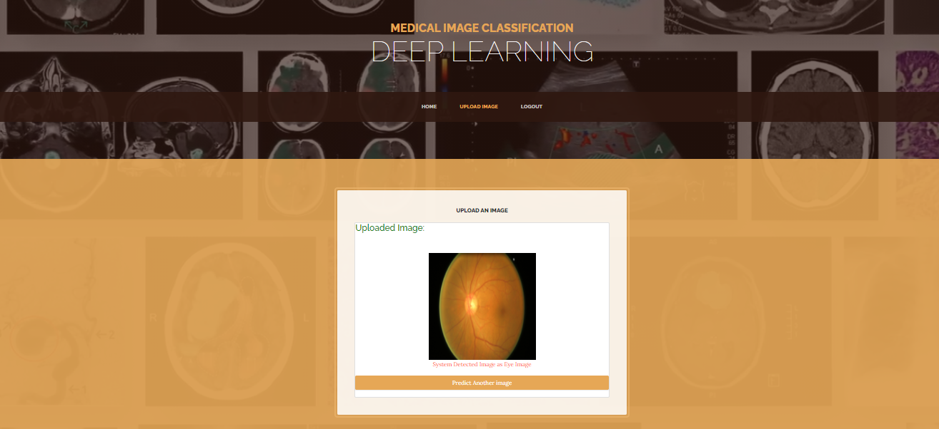
Output image classified as Eye:
Fig6: Output image classified as Eye

Slide 25
Thank You

